Slide 1
Analog to Digital Converters (ADC)
Ben Lester, Mike Steele, Quinn Morrison

Slide 2
Topics
Introduction
Why?
Types and Comparisons
Successive Approximation ADC example
Applications
ADC System in the CML-12C32 Microcontroller

Slide 3
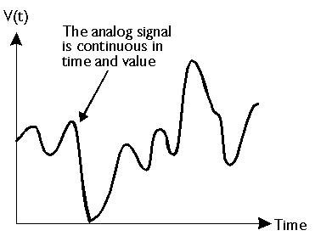
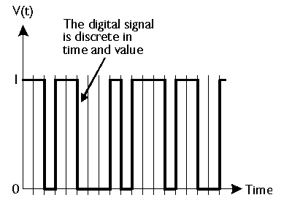
Analog systems are typically what engineers need to analyze. ADCs are used to turn analog information into digital data.
Notes:
a system that can produce many different values.
Voltmeter, thermometer, spedometer

Slide 4
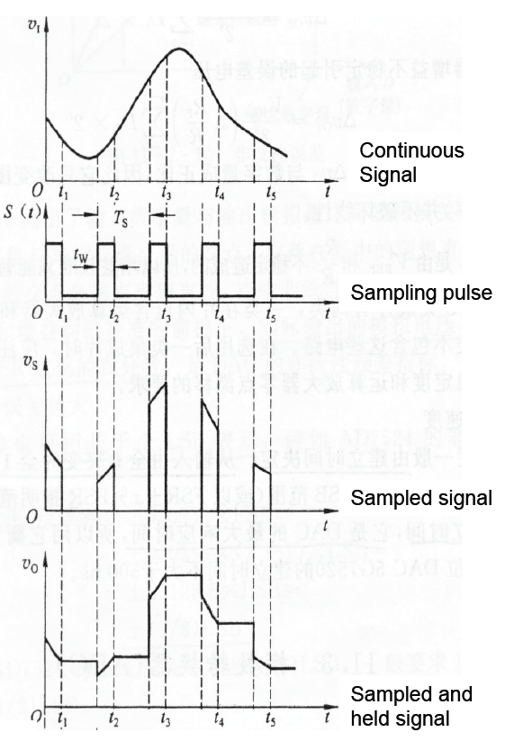
Process
Sampling, Quantification, Encoding
Output States | Discrete Voltage Ranges (V)
0 | 0.00-1.25
1 | 1.25-2.50
2 | 2.50-3.75
3 | 3.75-5.00
4 | 5.00-6.25
5 | 6.25-7.50
6 | 7.50-8.75
7 | 8.75-10.0
Out-put | Binary Equivalent
0 | 000
1 | 001
2 | 010
3 | 011
4 | 100
5 | 101
6 | 110
7 | 111
Notes:
Value of Digital system is taken at determined times, time samples Ts. Use Nyquist Theorem, fs>2*fmax;sampling frequency should be 2 times the max frequency of the analog output.
Quantification: Assigning of input to relative output state. Break up based on number of possible states determined by number of bits for the ADC.
In this example, since there are 8 states, it is a 3 bit ADC.
Encoding is changing the output state to it’s binary equivalent so that it can be used by the computer/circuit.

Slide 5
Resolution, Accuracy, and Conversion time
Resolution – Number of discrete values it can produce over the range of analog values; Q=R/N
Accuracy – Improved by increasing sampling rate and resolution.
Time – Based on number of steps required in the conversion process.
Notes:
Accuracy- higher sampling rate will increase the number of time intervals and resolution will get the output value closer to the analog value.
Speed – varies by type

Slide 6
Comparing types of ADCs
Flash ADC
Wilkinson ADC
Integrating ADC
Successive Approximation Converter

Slide 7
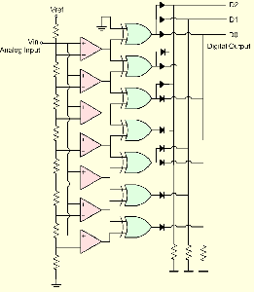
Flash ADC
Speed: High
Cost: High
Accuracy: Low
Notes:
Image: http://www.acclivities.com/images/clip_image007.gif
Comparator connected to logic switch to encode. Direct conversion ADC.

Slide 8
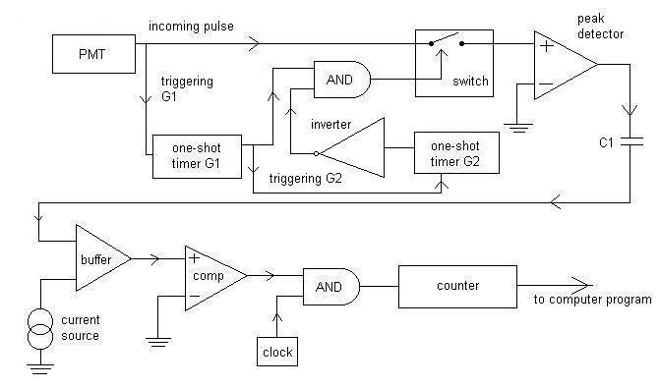
Wilkinson ADC
Speed: High
Cost: High
Accuracy: High
Wilkinson Analog Digital Converter (ADC) circuit schematic diagram
Notes:
http://fs6.depauw.edu:50080/~akomives/DUNPLweb/summer03/orlayposter.ppt

Slide 9
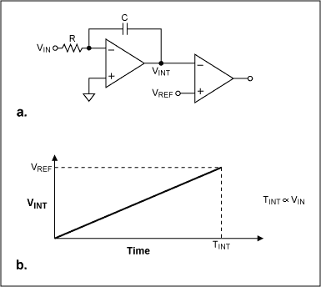
Integrating ADC
Speed: Low
Cost: Low
Accuracy: High
Notes:
http://www.maxim-ic.com/app-notes/index.mvp/id/1041

Slide 10
Successive Approximation Converter
Speed: High
Cost: High
Accuracy: High but limited
Notes:
“Because the approximations are successive (not simultaneous), the conversion takes one clock-cycle for each bit of resolution desired. The clock frequency must be equal to the sampling frequency multiplied by the number of bits of resolution desired “

Slide 11
Successive Approximation ADC Example
Mike Steele
Goal: Find digital value V_{in}
8-bit ADC
V_{in} = 7.65
V_{full scale} = 10

Slide 12
Successive Approximation ADC Example
MSB ➔ LSB
Average high/low limits
Compare to V_{in}
V_{in} > Average ➔ MSB = 1
V_{in} < Average ➔ MSB = 0
Bit 7
(V_{full scale} +0)/2 = 5
7.65 > 5 ➔ Bit 7 = 1
V_{full scale} = 10, V_{in} = 7.65
1

Slide 13
Successive Approximation ADC Example
MSB ➔ LSB
Average high/low limits
Compare to V_{in}
V_{in} > Average ➔ MSB = 1
V_{in} < Average ➔ MSB = 0
Bit 6
(V_{full scale} +5)/2 = 7.5
7.65 > 7.5 ➔ Bit 6 = 1
V_{full scale} = 10, V_{in} = 7.65
1 | 1

Slide 14
Successive Approximation ADC Example
MSB ➔ LSB
Average high/low limits
Compare to V_{in}
V_{in} > Average ➔ MSB = 1
V_{in} < Average ➔ MSB = 0
Bit 5
(V_{full scale} +7.5)/2 = 8.75
7.65 < 8.75 ➔ Bit 5 = 0
V_{full scale} = 10, V_{in} = 7.65
1 | 1 | 0

Slide 15
Successive Approximation ADC Example
MSB ➔ LSB
Average high/low limits
Compare to V_{in}
V_{in} > Average ➔ MSB = 1
V_{in} < Average ➔ MSB = 0
Bit 4
(8.75+7.5)/2 8.125
7.65 < 8.125 ➔ Bit 4 = 0
V_{in} = 7.65
1 | 1 | 0 | 0

Slide 16
Successive Approximation ADC Example
MSB ➔ LSB
Average high/low limits
Compare to V_{in}
V_{in} > Average ➔ MSB = 1
V_{in} < Average ➔ MSB = 0
Bit 3
(8.125+7.5)/2 = 7.8125
7.65 < 7.8125 ➔ Bit 3 = 0
V_{in} = 7.65
1 | 1 | 0 | 0 | 0

Slide 17
Successive Approximation ADC Example
MSB ➔ LSB
Average high/low limits
Compare to V_{in}
V_{in} > Average ➔ MSB = 1
V_{in} < Average ➔ MSB = 0
Bit 2
(7.8125+7.5)/2 = 7.65625
7.65 < 7.65625 ➔ Bit 2 = 0
V_{in} = 7.65
1 | 1 | 0 | 0 | 0 | 0

Slide 18
Successive Approximation ADC Example
V_{in} = 7.65
MSB ➔ LSB
Average high/low limits
Compare to V_{in}
V_{in} > Average ➔ MSB = 1
V_{in} < Average ➔ MSB = 0
Bit 1
(7.65625+7.5)/2 = 7.578125
7.65 > 7.578125 ➔ Bit 1 = 1
1 | 1 | 0 | 0 | 0 | 0 | 1

Slide 19
Successive Approximation ADC Example
MSB ➔ LSB
Average high/low limits
Compare to V_{in}
V_{in} > Average ➔ MSB = 1
V_{in} < Average ➔ MSB = 0
Bit 0
(7.65625+7.578125)/2 = 7.6171875
7.65 > 7.6171875 ➔ Bit 0 = 1
V_{in} = 7.65
1 | 1 | 0 | 0 | 0 | 0 | 1 | 1

Slide 20
Successive Approximation ADC Example
V_{in} = 7.65
11000011₂ = 195₁₀
8-bits, 2⁸ = 256
Digital Output
195/256 = 0.76171875
Analog Input
7.65/10 = 0.765
Resolution
(V_{max} – V_{min})/2^{n} ➔ 10/256 = 0.039
Voltage
Bit
1 | 1 | 0 | 0 | 0 | 0 | 1 | 1

Slide 21
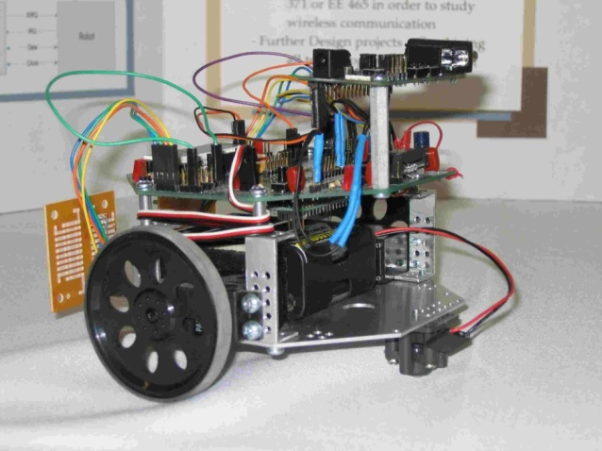
ADC Applications
Measurements / Data Acquisition
Control Systems
PLCs (Programmable Logic Controllers)
Sensor integration (Robotics)
Cell Phones
Video Devices
Audio Devices
e*(∆t)
Controller
u*(∆t)
e
e*
0010
1011
0101
0011
1001
0101
0010
1010
t
t
∆t
∆t

